Slide 1

CNH NEW HOLLAND TRACTOR TOOL TRACKINMG

Slide 2
Requirment
Customer wants to track differents types of tools like battery type Screw tool and Drill machine , metal hands tool .
Same tool is using in different station like bumffer fitting in tractor and like that there are differents stations .
Every station is having 10 tpyes of tools in every stations , total area of the stations is approx 200 meter .
Now what customer is looking they want to track every tools with the help of RFID which will track every tools inside the stations , if any tools are missing they want to know where is my tools and which location tools are missing .
For that we are trying to do POC in same stations where multiple tools are there and we have fixed Impinj Reader along with 2 antenna and we have fixed metal tags in each and every tools and trying to read the tools .
Same tools are reading the rfid tags when the tools are moving only , and when the tools are in working condition it is not reading properly , even when tools are in static condtion some times it is reading and some times stop the readings

Slide 3
Solution Suggest
We have done POC with Active Integrated Reader with Active Tags and the same project has been got successful at the plant end .
We have fixed Active Integrated Reader in one station on TOP Head and we have fixed active RFID Tags in diffrents tools and then we get all the tags data in a one slot without fail .
We have tested the same tools in runing condtion , when the person is using same tools then we are also trying to read same tags and it is reading successful .
Active Integarted Reader reading range is 100 meter in normal condtion , but in plant there are difffrent kind of machine is runing at the same stations and tag is reading properly withou any error.
We are using only Active Integrated reader and active tags and in this enviroments our reader is reading 50 meters .

Slide 4
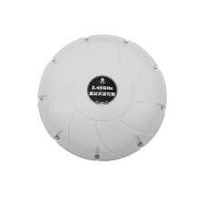
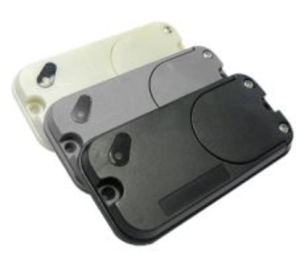
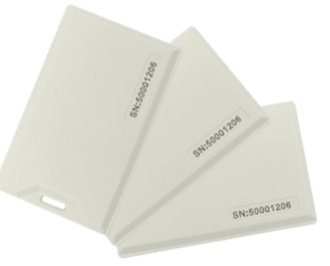
Hardware Use
Integrated Active RFID Reader
STA F526B Active Reader
Long range active battery powered rfid tag active rfid label
Active RFID Battery Replaceable LED & Buzzer Tag

Slide 5
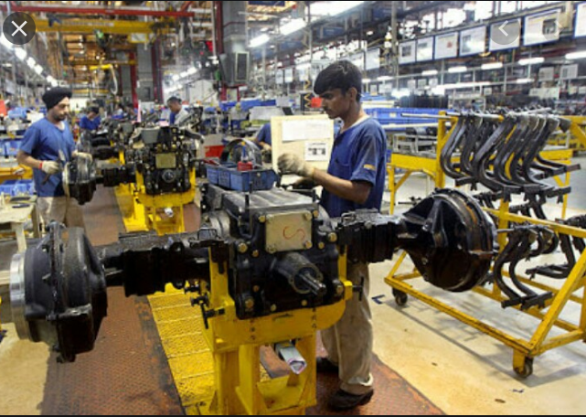

An RFID tag is attached to the items either to individual tool or an metal runing tools. At each stations, there is an RFID Readers with many antennas. When a tool movies to one station to other stations it will generate alarms , otherwise it is only reading rfid tags .
If the same tool are at same stations our reader is continiously reading rfid tags , but when somone is trying to theft or move to other places it will generate notification to the partcicular supervisor so that they can know about the particular tools.

Slide 6
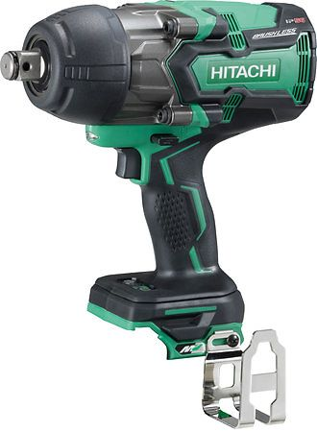
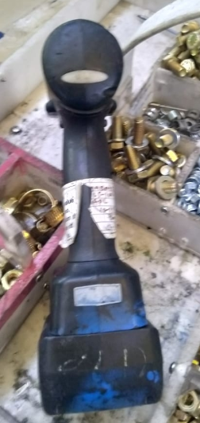
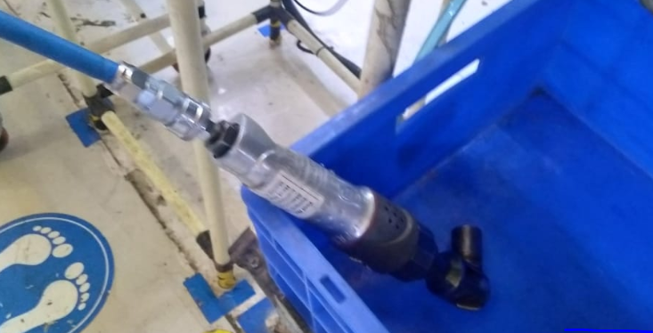
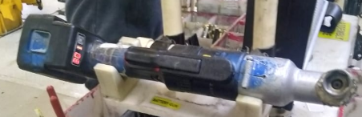
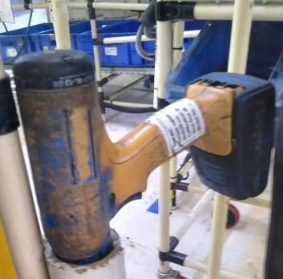
Differents Type of Tools inside plants

Slide 7
Advantage of Tool Trackings
The tags can be attached to every tools like metal tools or battery type tools.
Several tags can be read at once, enabling an entire tools keeping every tools in each stations.
Tags can be given unique identification codes, so that individual tools can be tracked
Certain tags can be overwritten, enabling information about items to be updated.

Slide 8
Solution Benifits
Overall reduction of lost and stolen tools.
Increase in accountability and traceability of company assets.
Elimination of “hands-on” human/compliance element from tool tracking system.
Elimination of lost man-hours.
Increase in revenue.

Slide 9
Thank You
THANK Y
For your wathcing

